Slide 1

Somerford Keynes Parish Council
AGM, May 24th 2024

Slide 2
Agenda
Andy Clark - Parish Council Overview
Nick Cartwright – Village Lake
James Ponting – Lower Mill Estate Ecologist
Matthew Millett – Cotswold Lakes Trust Development Director
Mike McKeown – Cotswold District Council and Thames Head Energy
Open Forum

Slide 3
Your Parish Councillors
Andy Clark – Chair
Graham Valentine – Finance
Hillary Collins - Flooding
John Whitwell – Environment & Footpaths
Mandy Keegan – Planning
Mark Hastie-Oldland – Highways
Nick Hunt – Local Business and Other Organisations
Karen Holdsworth – Parish Clerk

Slide 4
Parish Council Objectives
Maintain the character of the parish in line with the Neighbourhood Development Plan and feedback from the most recent community survey.
Develop a sustainable financial plan for the next five years.
Document a flood protection plan for the parish.
Invest the Community Infrastructure Levy funds in line with agreed investment guidelines.
Maintain positive relationships and open dialogue with parishioners and other stakeholders such as District and County Councils, Cotswold Lakes Trust and other local bodies.
Seek opportunities to enhance the community infrastructure; includes utilities, pavements and footpaths.

Slide 5
Financial Summary
Increased Precept from £4000 to £6300 for 2024/25
In order to provide income to cover expected spend
Takes it to £14.65 per household versus CDC average of £99.51
Moved to Online Banking
Put Money into Interest Earning Accounts
Received Significant Community Infrastructure Levy Funds
Agreed Budget for Village Lake of £1250.00 pa (from Parish Field rental)
Seeking Other Funding Opportunities
Active Travel Fund, Build Back Better, Rural England Prosperity Fund, Community Infrastructure Grants

Slide 6
Income and Expenditure Excluding CIL
2023/24 2022/23
Income
Precept 4000 4000
Parish Field Rent 1575 1500
VAT Reclaim 552 1090
Total Income 6127 6590
Expenditure
Clerk’s Salary 3704 3055
Essential Spend 1059 856
Other Expenses 641 551
Village Lake 1182 1222
Parish Field Legal 770
Total Expenditure 6586 6454
Surplus (459) 136
Excl VAT Reclaim (1011) (954)
Essential spend includes software and other subscriptions, insurance, audit, defribulator maintenance
Other expenditure includes printing, support for events such as litter picking, training

Slide 7
Parish Council Financial Holdings
April 1st 2024 April 1st 2023 Change
General Reserves £3,293.01 £3,949.73 -£656.72
Calor Funds (Village Lake)* £428.00 £428.00 0
Community Infrastructure Levy* £66,063.58 £12,820.74 £53,242.84
Total £69,784.59 £17,198.17 £52,586.42
*Denotes Funds With Restricted Use
Further £35,640.77 CIL Received April 24th 2024

Slide 8
Investing Community Infrastructure Levy Funds
CIL Investment Criteria
Number of parishioners who would benefit
Whether it benefits currently under served groups
No ongoing maintenance costs and obligations
A low level of ongoing management/volunteer input required
Possible Projects
Village Hall – Kitchen, Heating, Audio Visual
Missing Link Cycle Path, SK to Ashton Keynes crossroads
New Notice Board
Play Equipment
Village Lake Projects
Flood Prevention – Contribution to Env Agency moving pump?
Church
No CIL money was spent in 2023/24.
In 2022/23 £2000 was spent on community energy and £1463 on Village Lake boardwalk

Slide 9
Community Survey Feedback
A Great Place to Live
Over 80% of respondents have lived here more than 10 years
Excellent community spirit
Combines rural nature with access to transport links and towns and cities
Concerns and Priorities
Retain the nature of the community and avoid urbanisation
Planning – only support that which complies with Neighbourhood Development Plan
What People Want
Shared green space/childrens’ play area
Infrastructure – mains sewerage and fibre broadband
Extended green access – footpaths, cycle ways

Slide 10
Mike McKeown
Annual Report 2023/24
Kemble Ward Councilor
Cabinet Lead for Climate Change & Sustainability
Thames Head Energy Co-Founder

Slide 11
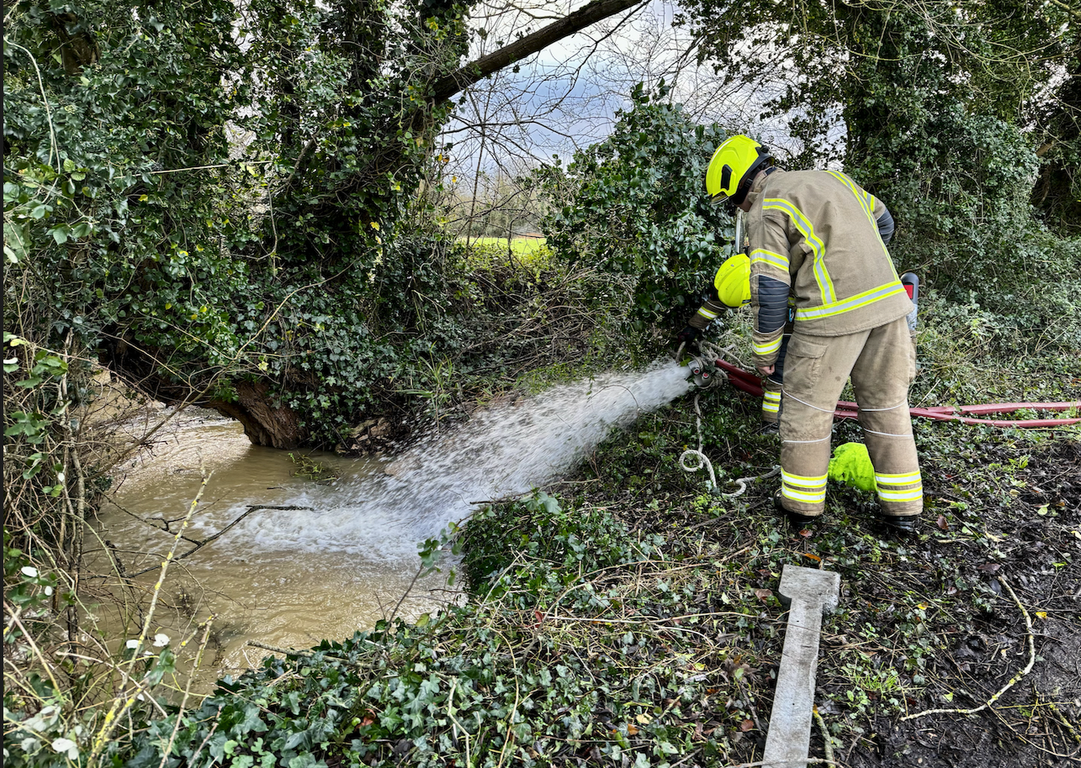
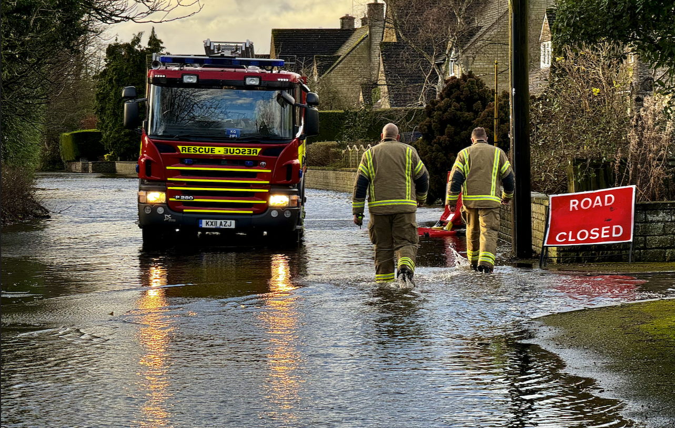

Flooding

Slide 12
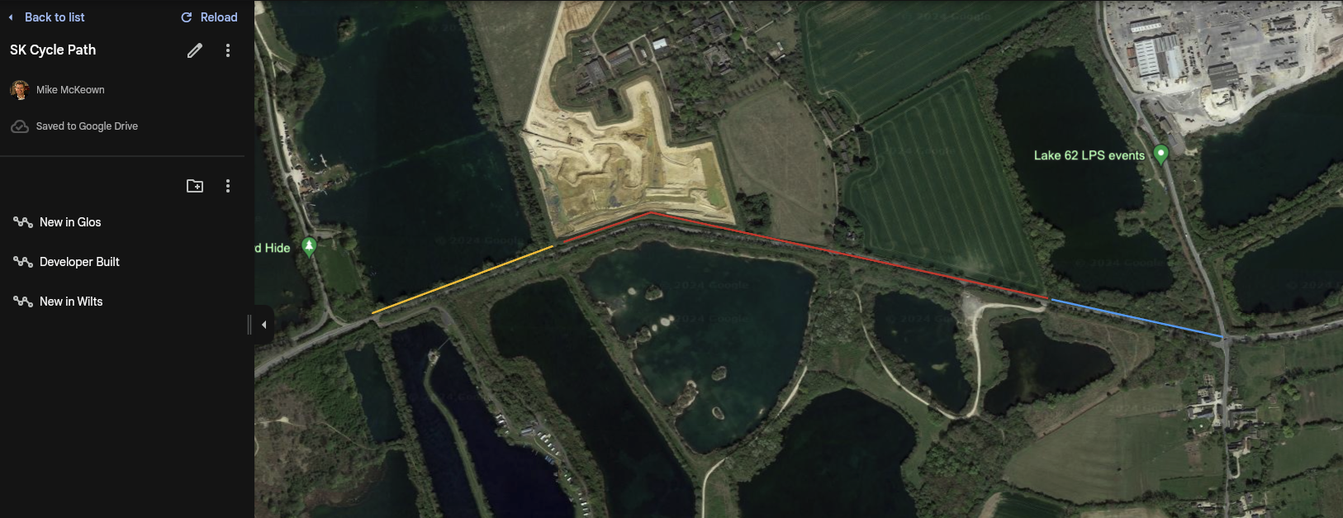
Cycle Paths

Slide 13
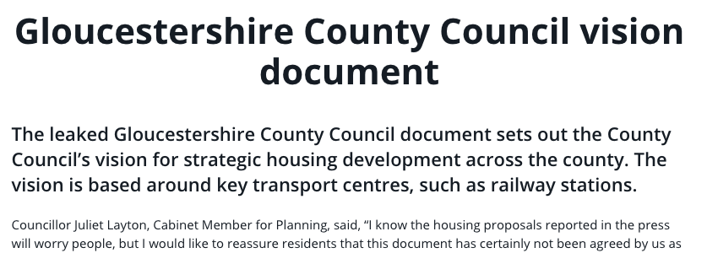

Slide 14
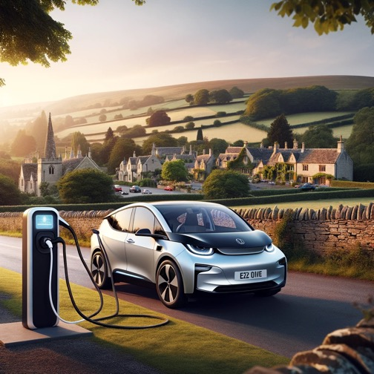
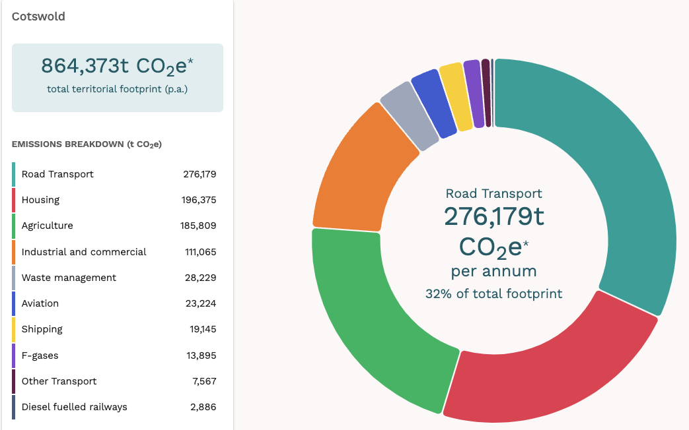
EV Chargers
£191,000 grant
66 chargers
11 car parks
#1

Slide 15

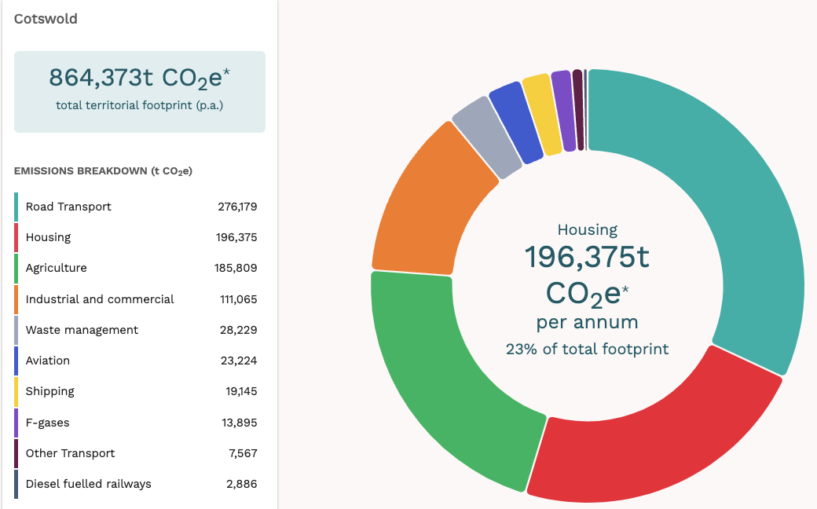


Retrofit
£100,000 Grant
CDC, Cheltenham BC, Forrest DC & CLG
Community engagement & advice
Heat pumps, insulation & solar
#2

Slide 16

Thames Head Community Energy

Slide 17
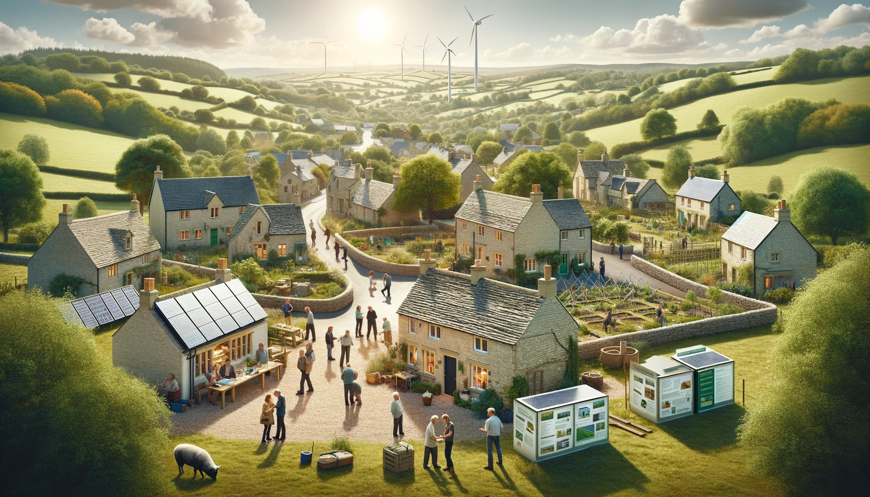
Thames Head Community Energy Update
£60,000+ funds raised
Community Benefits Society (CBS)
7 directors + Champions

Slide 18
Home Solar + Batteries
14 homes
~17 tonnes of CO2 saved per year
~£20,000 savings per year
~69mWh electricity = 280,000 EV miles per year
Battery only option

Slide 19
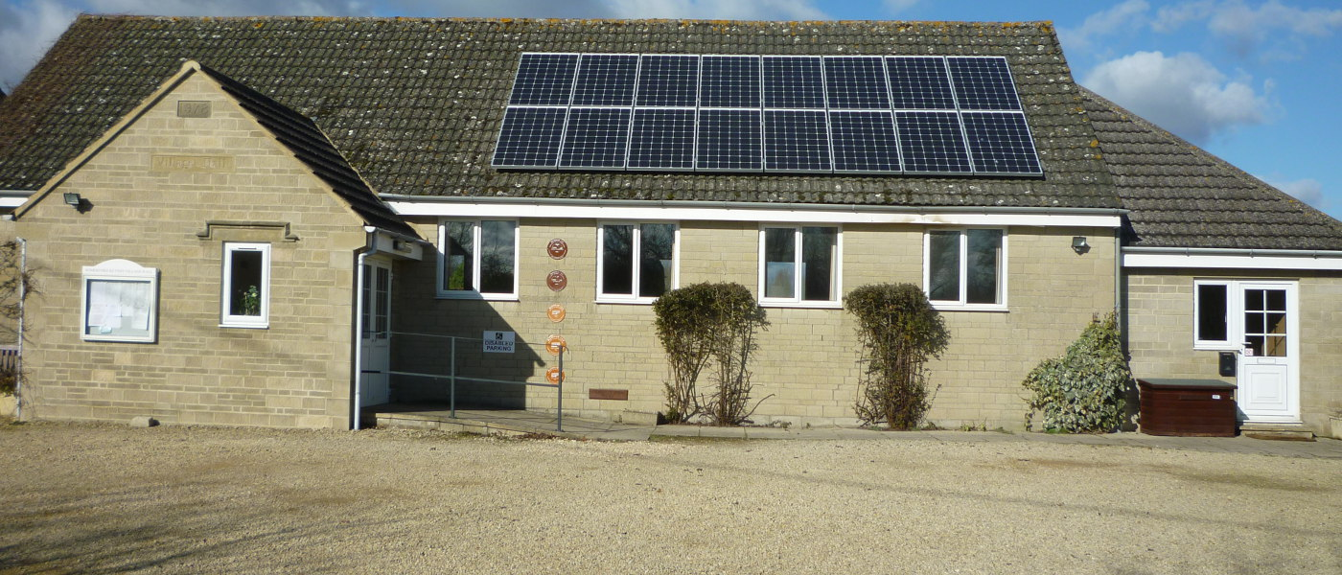
Village Hall Projects
New heating system
Grant application
EV Chargers
Grant funded

Slide 20
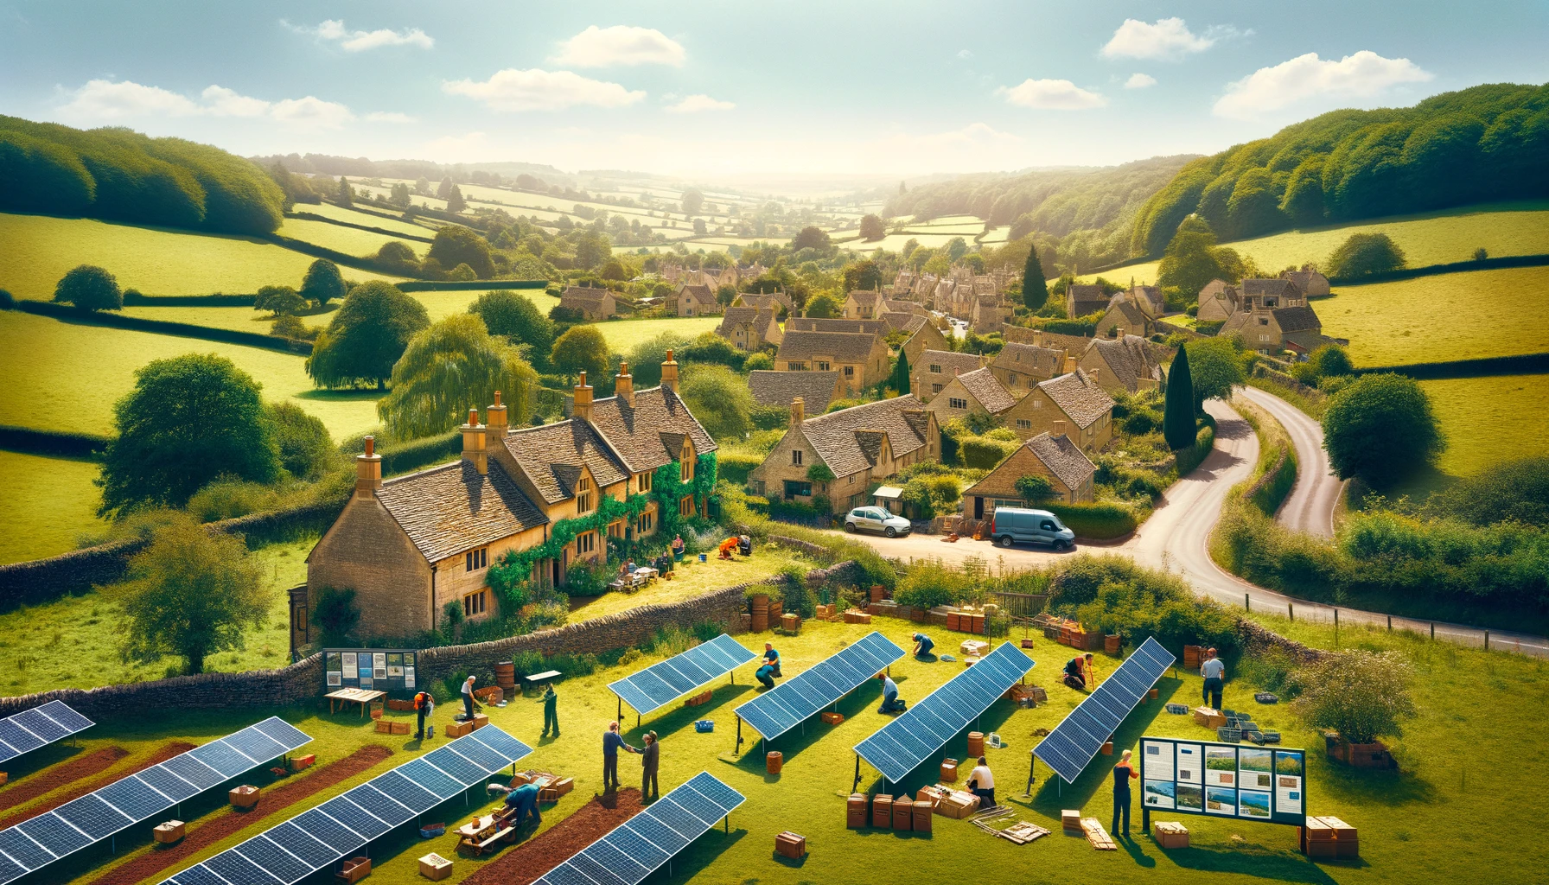
Community Solar Farm
£40,000 Grant Funding
Cotswold District
South Cotswolds Constituency
Profits to the communities

